Slide 1
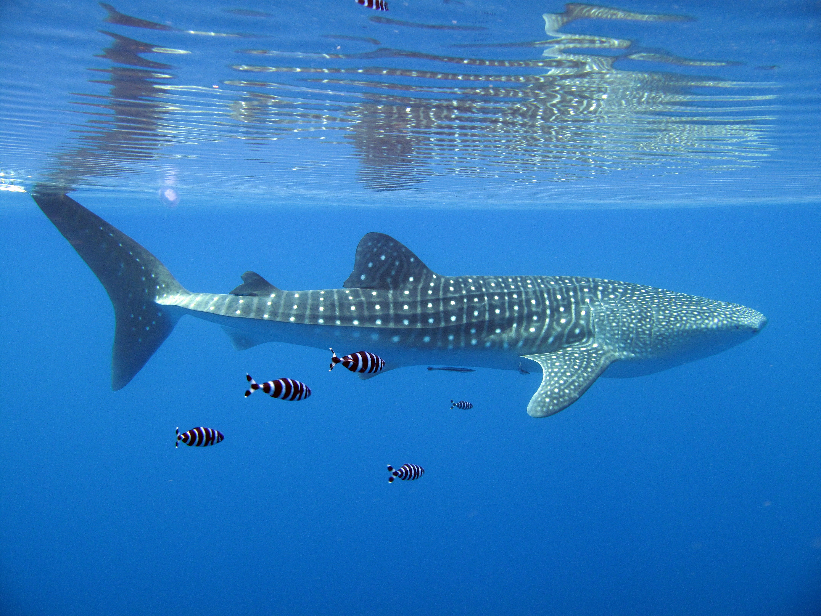
Acoustic Monitoring of a Red Sea Whale Shark Aggregation
Jesse Cochran, Michael Berumen, Greg Skomal, Simon Thorolld

Slide 2
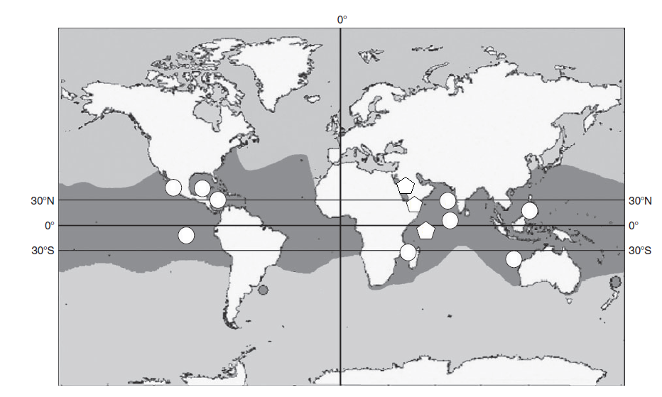
Figure adapted from Rowat et al. 2011

Slide 3
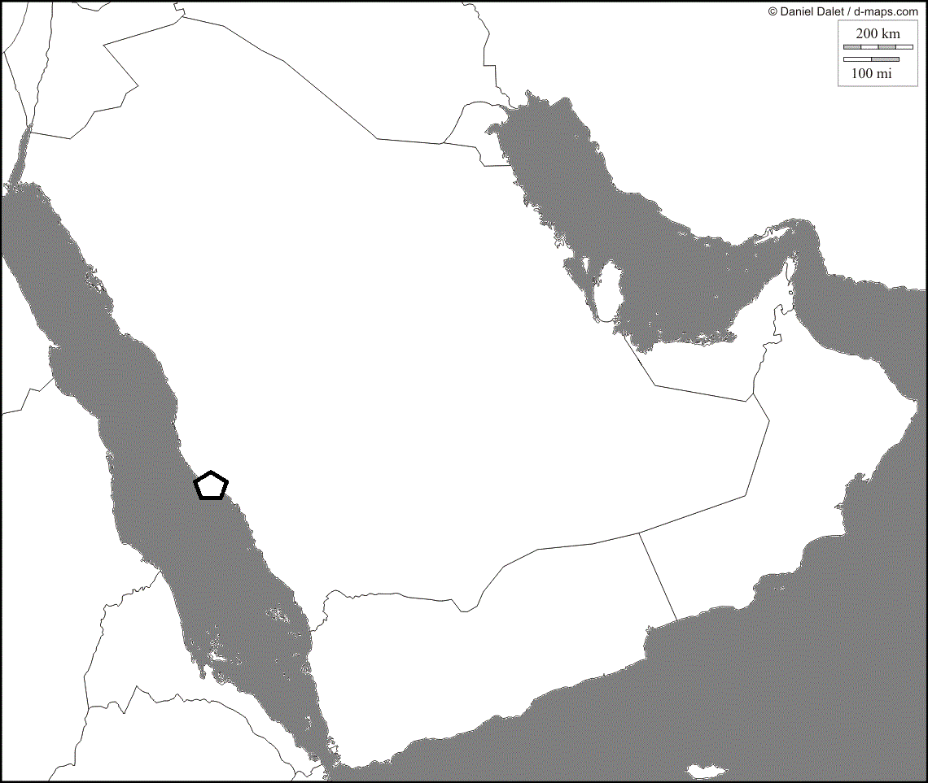

Slide 4
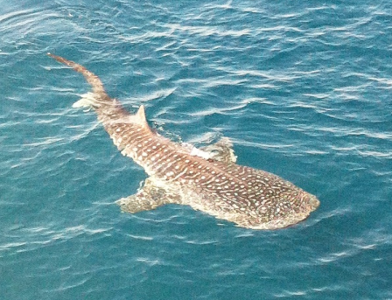
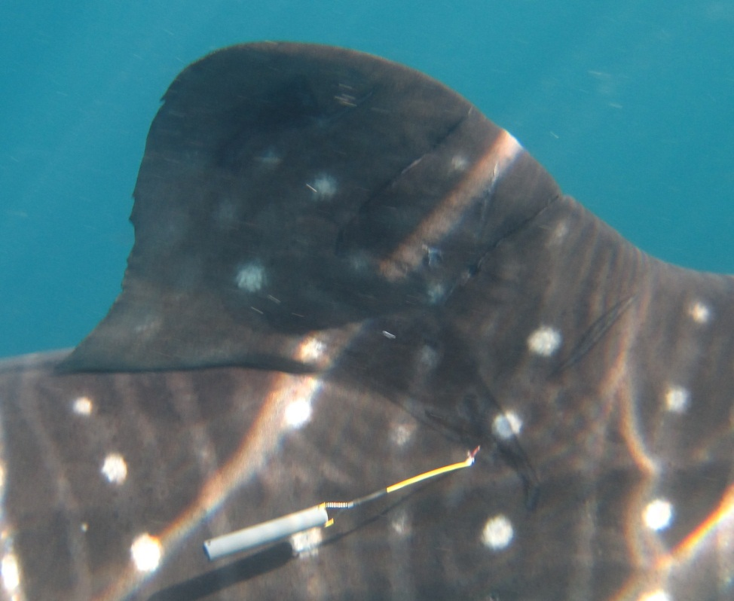
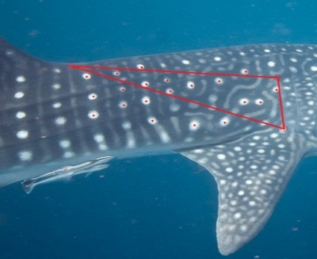
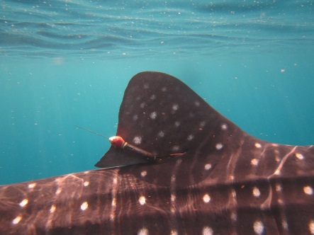
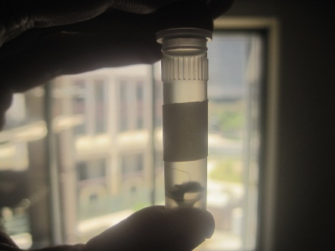
Sighting Data
Photo Identification
Satellite Telemetry
Genetic Analysis
Acoustic Monitoring

Slide 5
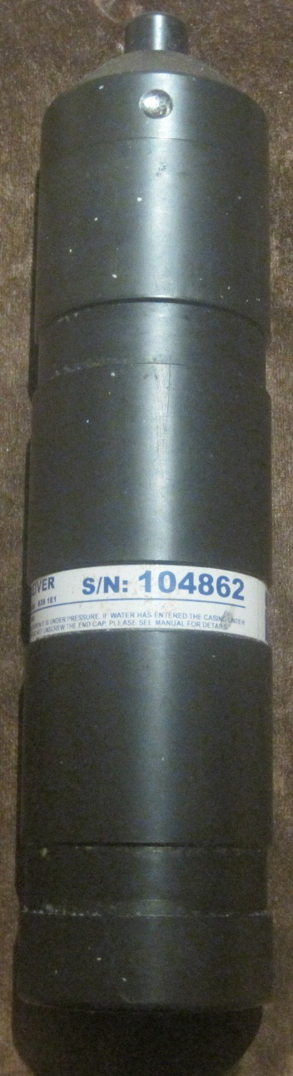
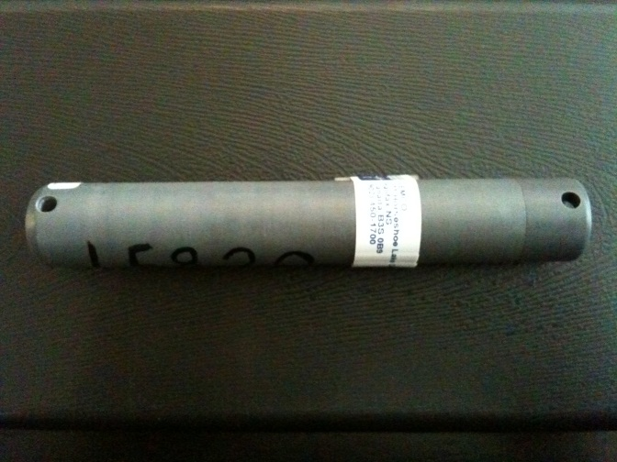
Materials and Methods

Slide 6
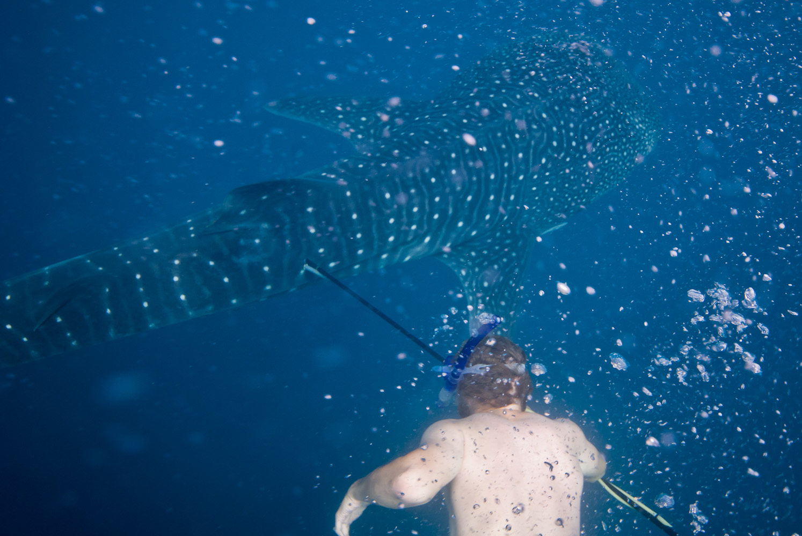

Slide 7
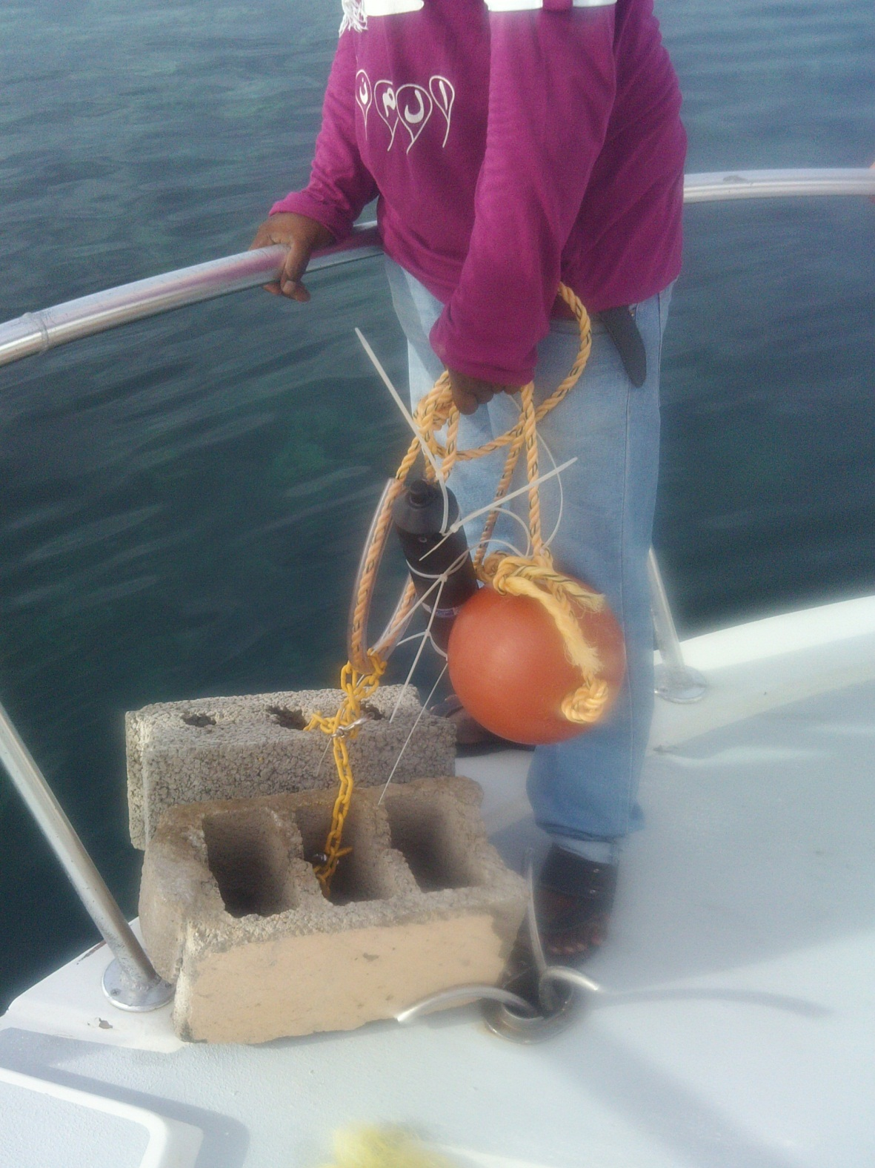

Slide 8
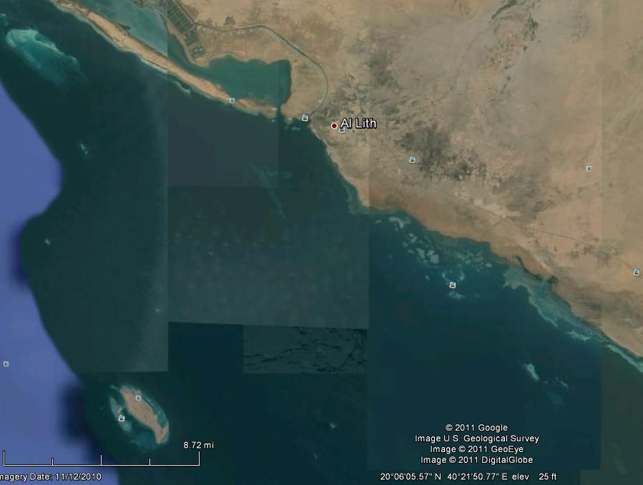

Slide 9
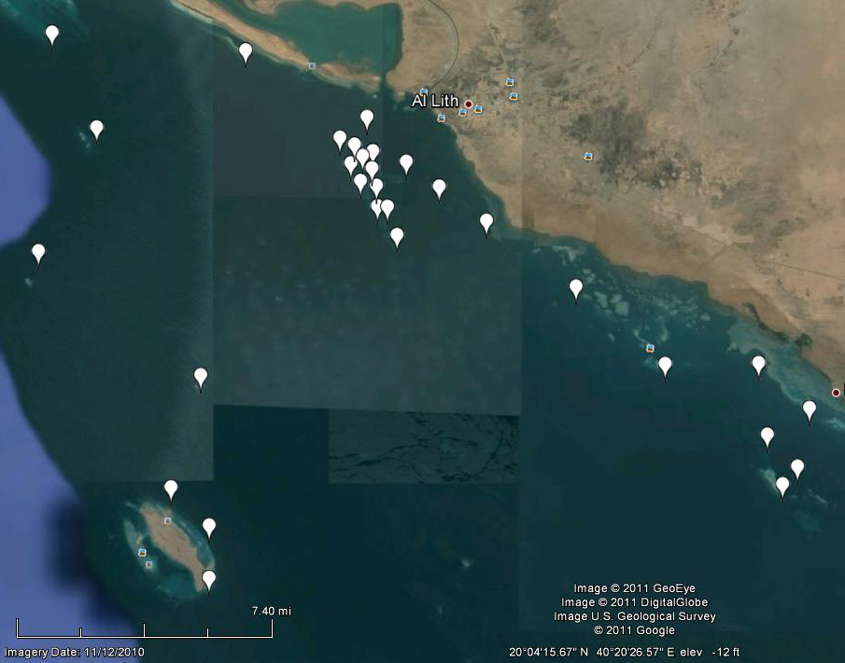

Slide 10
By the Numbers
Array of 28 receivers
65 tagged sharks
  28 males, 24 Females, 16 undetermined
  Size range of 3-6m
2 years of monitoring
31443 whale shark detections

Slide 11
Results
Temporal
  What is the seasonality of the aggregation?
  Do sharks return over multiple years?
Spatial
  What areas are the sharks using when they are on site?
  How are they using the water column?
Sexual
  How does the above relate to the sharks’ gender?

Slide 12
Temporal (Seasonality)

Slide 13
Temporal (Site Fidelity)

Slide 14
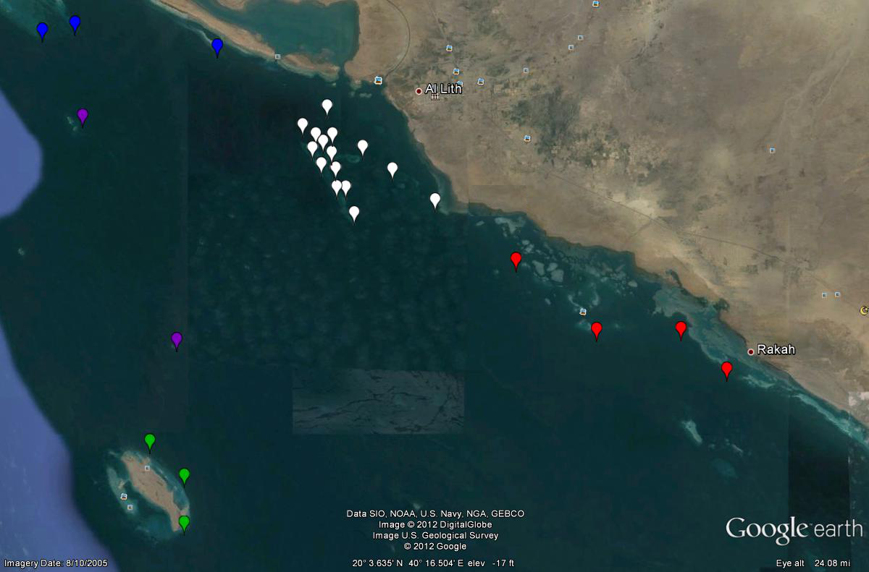
Spatial (General Habitat Use)
5293
32
25,768
221
43

Slide 15
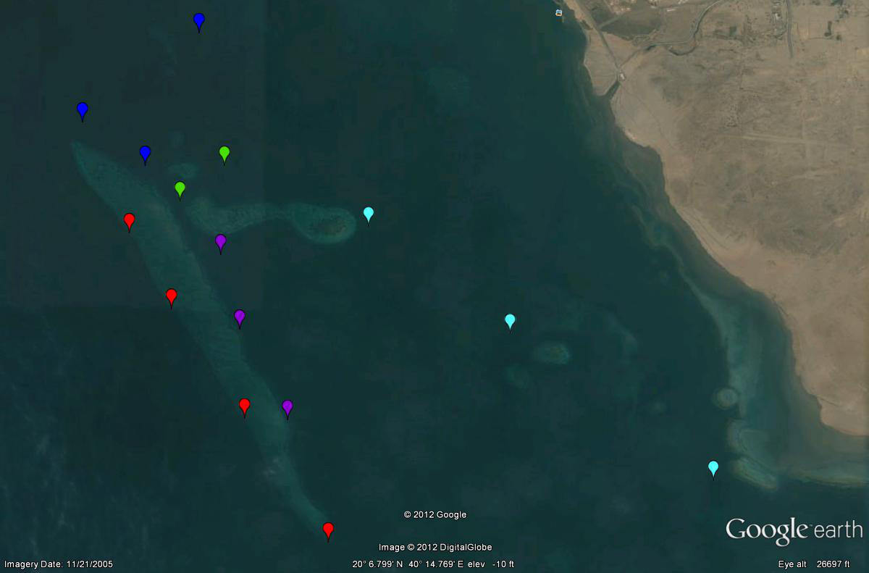
Spatial (Shib Habil Habitat use)
10305
3400
North inshore 5293
1955
136
9970

Slide 16
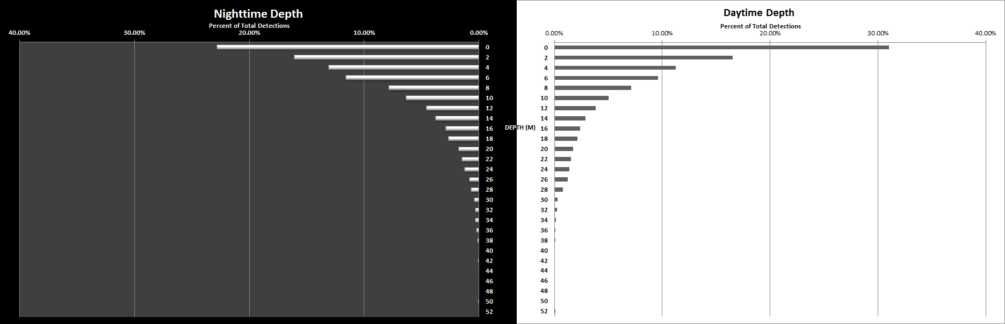
Spatial (Vertical Habitat Use)

Slide 18
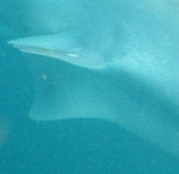
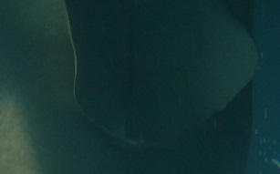
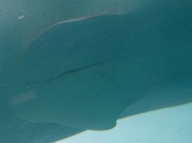
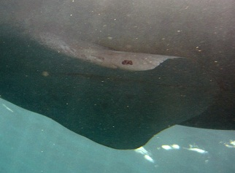
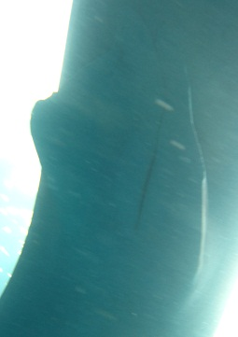
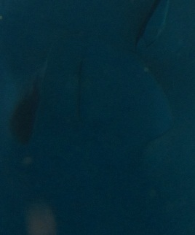
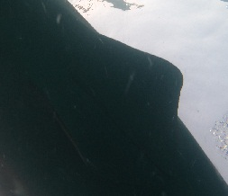

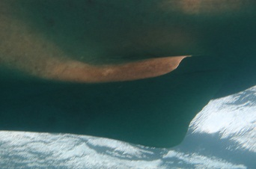
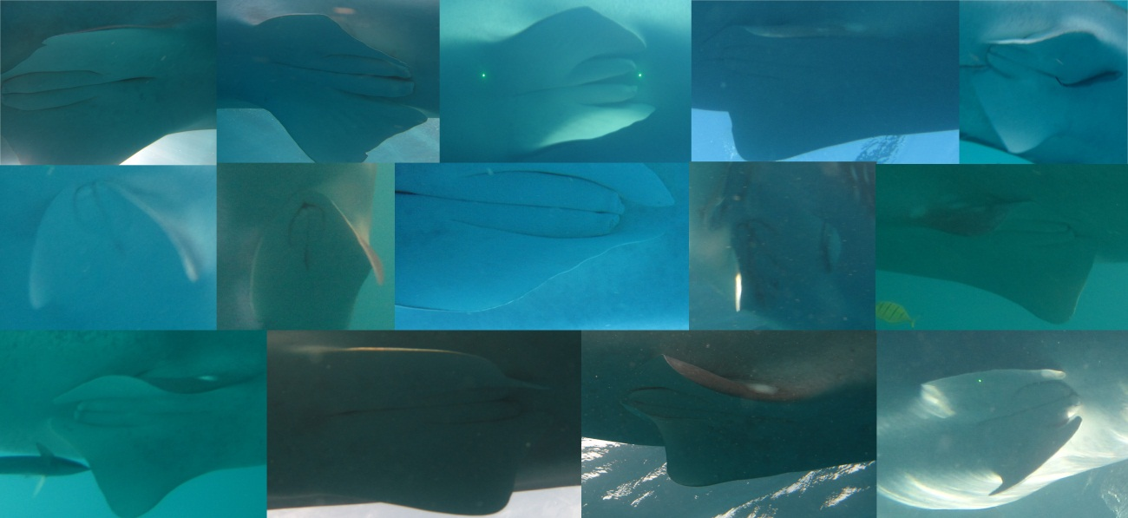
Gender

Slide 19
Gender

Slide 20
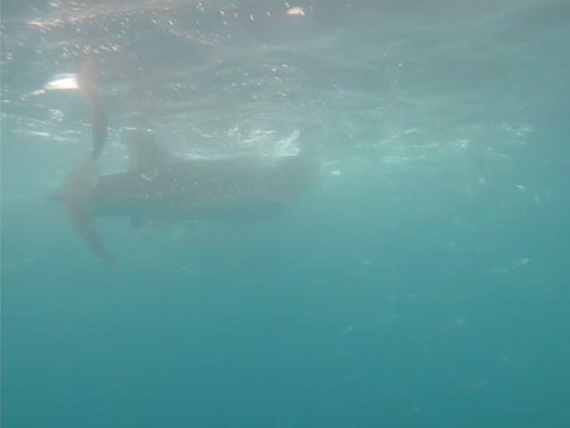

Slide 21
Breeding?
Size range 3-6m, size at maturity is 8-10 m
The claspers of the males are small, undeveloped, and not yet usable for mating.

Slide 22
Future Work
Continued acoustic monitoring
Plankton Assessments
Expansion to a new site for comparative analysis

Slide 23



Acknowledgments
Pedro De La Torre, Noah Derosiers, Keith Gehres, Gerrit Nanninga, Julia Spaet, Maha Khalil,
Fernando Cagua, Jessie Masterman, Jess Bouwmeester, Liz Laman Trip, Lizzie Tyler, Tane Sinclair-Taylor, Mark Priest , CMOR Staff

